Slide 1
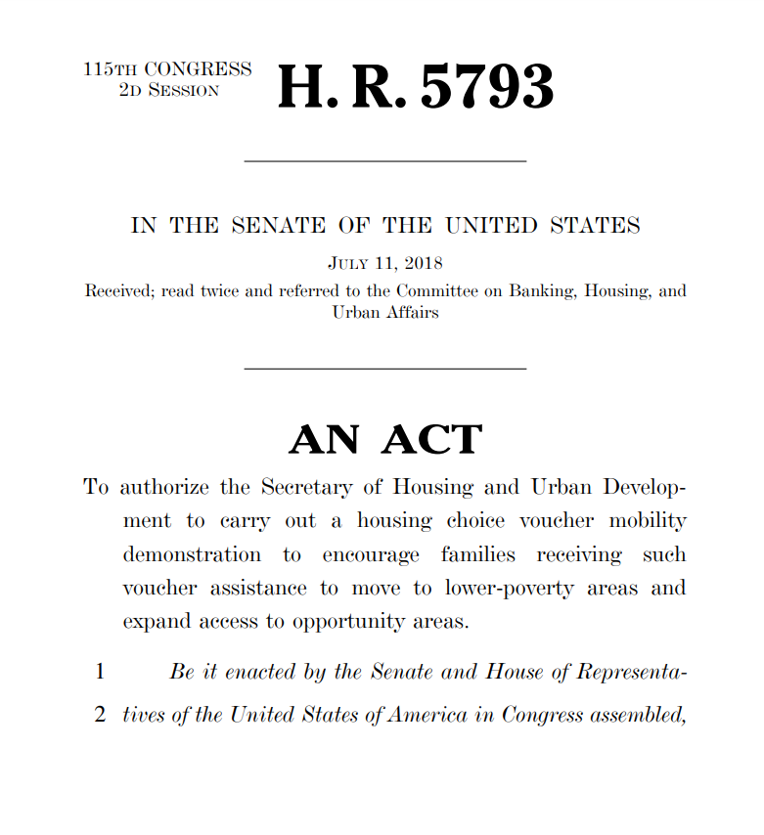
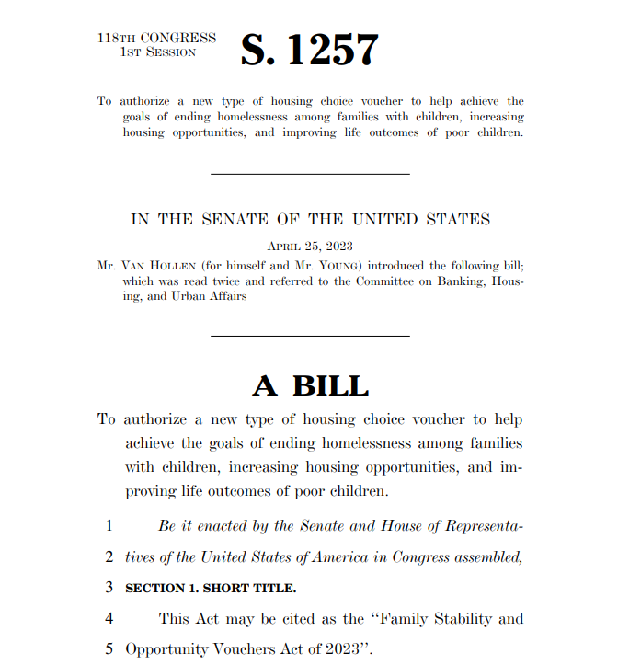

From Research to Policy
Impacts on Federal Affordable Housing Policies
2018
Housing Choice Voucher Mobility Demonstration Act
2023
Family Stability and Opportunity Vouchers Act
Social support increased moves to high-opportunity areas by 6x
Source: Congress.gov; Rapid Cycle Evaluation Report (HUD 2024)

Slide 2






Improving Economic Opportunity in Charlotte
$160M corporate investment in local workforce development
Land of Opportunity? Not by a long shot.
“When the headline broke about the Harvard University/UC Berkeley study that ranked Charlotte-Mecklenburg 50th out of 50 in upward mobility for children born into our lowest income quintile, many in our community responded with disbelief. How, on the one hand, can we be such a vital and opportunity-rich community, and on the other, be ranked dead last in the odds that our lowest income children and youth will be able to move up the economic ladder as they become adults?”
Mayor’s initiative raises $250M to boost opportunity in Charlotte
A local data tool developed to monitor opportunity indicators for >100 area nonprofits
Source: The Charlotte Observer (2018); YearUp & Bank of America | The Mayor’s Initiative | Leading on Opportunity

Slide 3







Housing Policy at the Local and Federal Levels
Expanding families’ access to high opportunity neighborhoods
U.S. Department of Housing and Urban Development
Creating Moves to Opportunity
Seattle, WA
CMTO, a pilot program in Seattle, tested strategies to help families with housing choice vouchers move to high-opportunity neighborhoods.
HUD launches $75M Community Choice Demonstration project in CA, LA, MN, NY, OH, PA, and TN to replicate the Seattle CMTO approach.
U.S. Congress
A Better Address Can Change a Child’s Future
Bipartisan bill, Family Stability & Opportunity Vouchers Act, would add 250K vouchers ($5B/yr) to increase stability and geographic choice for families.
In Seattle, A Move Across Town Could Be A Path Out Of Poverty
Seattle may have figured out how to get more poor people into better housing
Source: CMTO | HUD’s Community Choice Demo | U.S. Congress

Slide 4





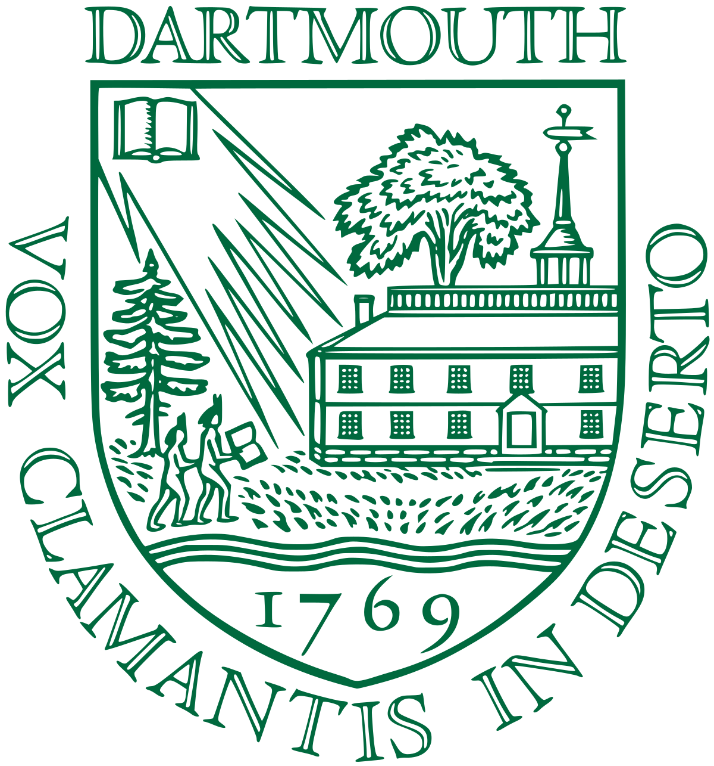







Higher Education Policies
Shifting policies in college rankings, standardized testing, and admissions
Some Colleges Have More Students From the Top 1 Percent Than the Bottom 60. Find Yours.
College Rankings
U.S. News updates college rankings to include emphasis on social mobility
The Misguided War on the SAT
Test scores can be particularly helpful in identifying lower-income students who will thrive.
Standardized Testing
Top colleges reinstate standardized test requirements for admissions
How The Admission Practices Of Elite Colleges Perpetuate The Advantages Of The Wealthy
Admissions Policies
Yale College uses place-based data from Opportunity Atlas in admissions review
States pass laws banning legacy and donor preferences in admissions
Source: Upshot | NYT | Forbes | Rankings | Testing: Brown | Caltech | Dartmouth | Harvard | Stanford | Yale | Admissions: California | Virginia | Minnesota

Slide 5
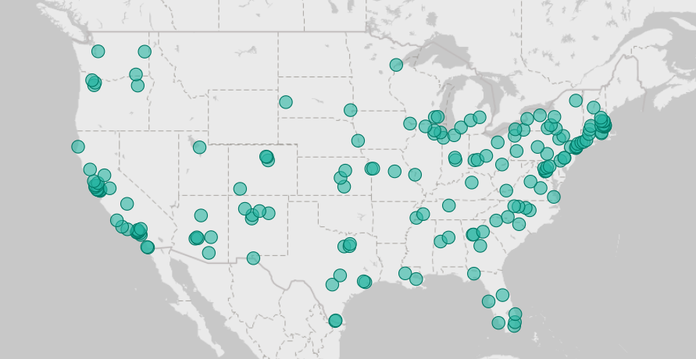

Using Data Science to Improve Economic Opportunity Across America
Communities Where Opportunity Insights Worked with Local Stakeholders in 2024
In 2024, Opportunity Insights engaged with 313 organizations across 179 cities in 41 states

Slide 6


Initiatives to Increase Cross-Class Interaction in High Schools
2017
A Structure of Division: Berkeley High School attempts to tackle segregation on campus
To attempt to address this divisive climate, Berkeley High’s Design Team has proposed the creation of a ninth grade that places incoming students into intentionally diverse communities. Under a universal ninth grade, students would begin their time at Berkeley High in one of various houses, rather than in one of the five learning communities.
Berkeley High School
Source: The Daily Californian (2017)

Slide 7
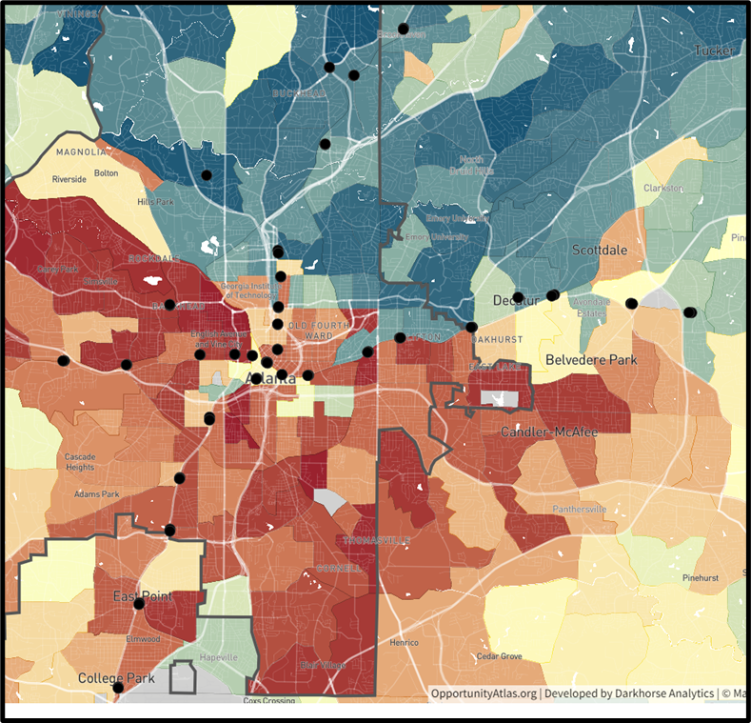


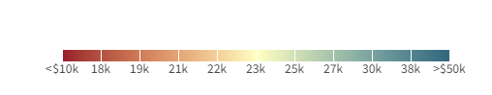
Increasing Cross-Class Interaction Through Urban Design
2023
Connecting Communities: Adding Soccer Fields to Atlanta’s MARTA Stations
MARTA Stations
Source: Urbanland (2023)

